Slide 1


Implement a cache partitioning scheme to improve performance in multi-core processors in C

Slide 2

Submitted To
Dr. Md. Nawab Yousuf Ali
Professor
Department of Computer Science and Engineering
East West University
Submitted By
1. Afsana Akter Mim (2023-1-60-073)
2. Nuran Farhana Prova (2023-1-60-075)
3. Farhatun Nahar Priya (2023-1-60-202)

Slide 3
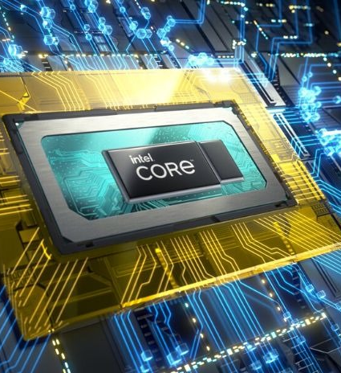
introduction
Shared L3 cache in multi-core systems causes conflicts.
Fixed way partitioning reduces interference.
Simulated 8-way set-associative cache in C for 4 cores.
POSIX threads handle concurrency; mutexes ensure sync.
Tracks hits/misses to show performance improvement.

Slide 4

Problem Statement
Shared cache :conflicts & cache thrashing.
More cache misses & poor performance.
Race conditions : data inconsistency.
Need: Fair cache partitioning for better performance & stability.

Slide 5

Cache Partitioning Concept
Cache Partitioning: Divides shared cache, giving each core its own part.
Fixed Way Partitioning Benefits:
Predictable cache use.
Fewer conflicts between cores.
Fair cache allocation.
Better performance and fewer misses.

Slide 6
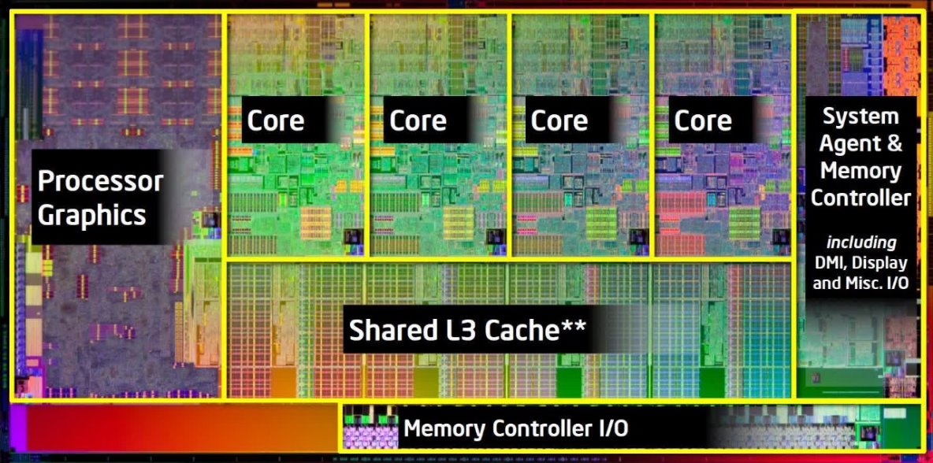
Project Design & Implementation
Cache Model: 8-way set-associative L3 cache.
Partitioning Scheme: Fixed way partitioning for 4 cores.
Concurrency Management: POSIX threads for parallel execution, mutex locks for synchronization.
Implementation: C-based simulation tracking cache hits/misses per core.
Data Structures & Algorithms: LRU-based cache replacement, dynamic memory access simulation.

Slide 7
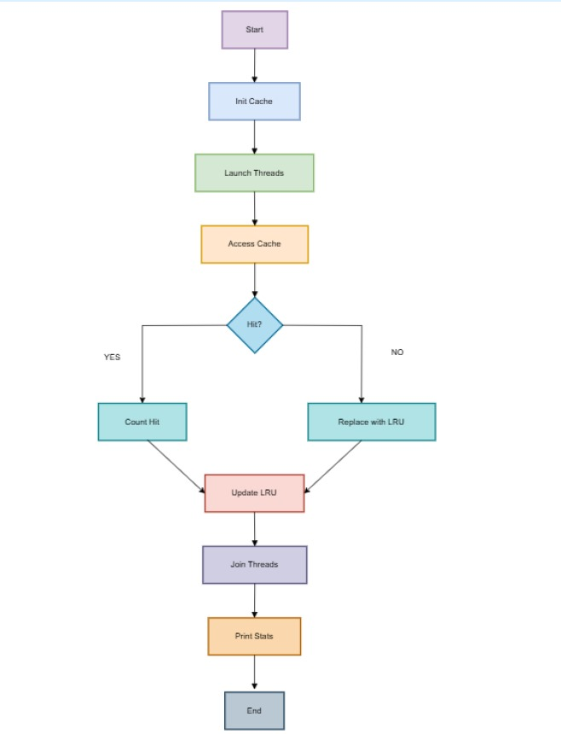

Flow Chart

Slide 8

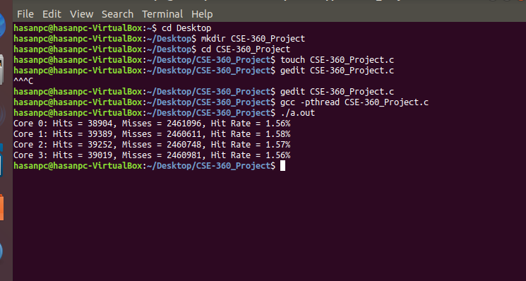
Output

Slide 9

Results & Analysis
Cache Efficiency: Tracks hit/miss stats per core.
Performance Gains: Reduced contention, improved utilization.
Fairness & Stability: Balanced cache allocation ensures predictability.
Result: Simulation shows higher cache hit rates, improved execution efficiency, and better resource distribution across cores.
Cache Hit/Miss Statistics:
Core 0: Hits = 3,914, Misses = 2,460,986, Hit Rate = 1.56%
Core 1: Hits = 39,235, Misses = 2,460,765, Hit Rate = 1.57%
Core 2: Hits = 39,081, Misses = 2,460,919, Hit Rate = 1.56%
Core 3: Hits = 39,031, Misses = 2,460,969, Hit Rate = 1.56%

Slide 10

Conclusion
Cache partitioning reduces conflicts and improves cache efficiency.
Fixed way partitioning ensures fair and predictable cache use across cores.
Simulation shows better performance and balanced resource sharing.
Future Work: Explore dynamic partitioning and adaptive cache management for further gains.

Slide 11


